Slide 1
Evaluating news sources
Notes:
Created by Mr. Richardson, MAT at GHHS from sources including
http://www.npr.org/2016/11/22/503052574/stanford-study-finds-most-students-vulnerable-to-fake-news
https://sheg.stanford.edu/upload/V3LessonPlans/Executive%20Summary%2011.21.16.pdf
https://www.washingtonpost.com/business/economy/russian-propaganda-effort-helped-spread-fake-news-during-election-experts-say/2016/11/24/793903b6-8a40-4ca9-b712-716af66098fe_story.html

Slide 2
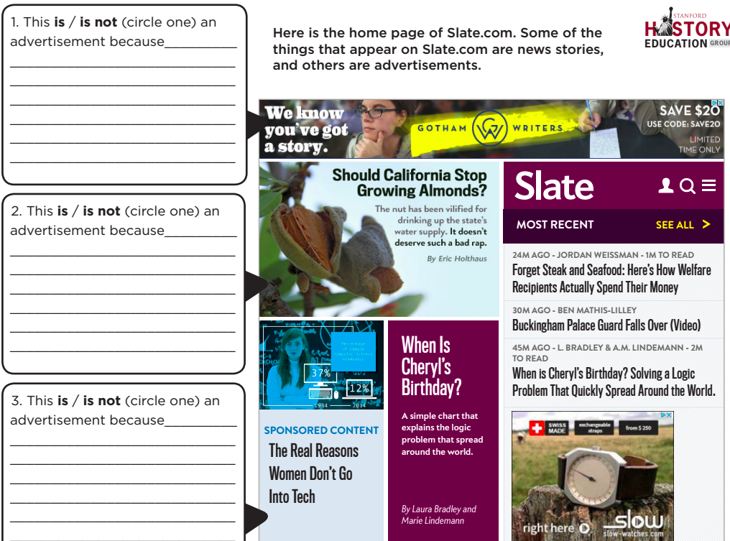
20% Wrong
10% wrong
80% wrong!!
Notes:
Many news organizations have turned to native advertising as a source of revenue. By definition, native advertising tries to sell or promote a product in the guise of a news story. Native advertising makes it difficult for unsuspecting readers to know if and when there is an ulterior motive behind the information they encounter. In this assessment, students are presented with the home page of Slate magazine’s website, which includes both news items and advertisements. The task assesses students’ ability to distinguish between an article and an advertisement. Students must evaluate three different sections of the web page—a traditional advertisement, a news story, and a native advertisement—and determine the nature of each. Successful students understand the different forms that advertising can take and identify both traditional and native advertising. They are also able to explain the features that distinguish a news story from an ad. W
Results indicated that students were able to identify traditional news stories and traditional advertisements: more than three-quarters of the students correctly identified the traditional advertisement and the news story. Unfortunately, native advertising proved vexing for the vast majority of students. More than 80% of students believed that the native advertisement, identified by the words “sponsored content,” was a real news story. Some students even mentioned that it was sponsored content but still believed that it was a news article. This suggests that many students have no idea what “sponsored content” means and that this is something that must be explicitly taught as early as elementary school.

Slide 3
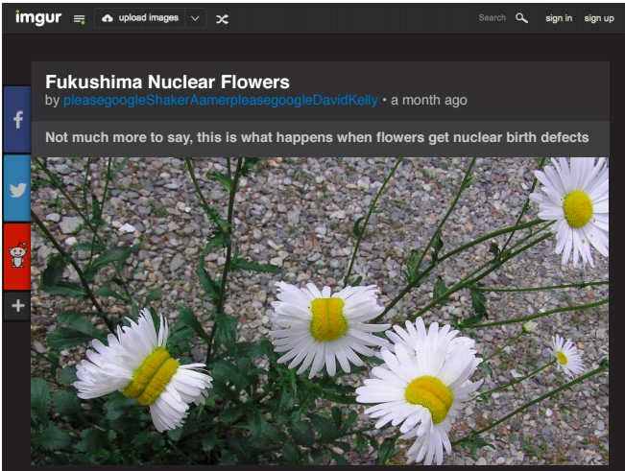
On March 11, 2011, there was a large nuclear disaster at the Fukushima Daiichi Nuclear Power Plant in Japan. This image was posted on Imgur, a photo sharing website, in July 2015
Does this post provide strong evidence about the conditions near the Fukushima Daiichi Power Plant? Explain your reasoning.
40% of high school students argued this was strong evidence
Notes:
Although the image is compelling and tempting to accept at face value, successful students will argue that the photograph does not provide strong evidence about conditions near the nuclear power plant. Students may question the source of the post, arguing that we know nothing about the credentials of the person who posted this photo (especially since it appears on a site where anyone can upload a photo). Alternatively, students may point out that the post provides no proof that the picture was taken near the power plant or that nuclear radiation caused the daisies’ unusual growth.
Less than 20% of students constructed “Mastery” responses, or responses that questioned the source of the post or the source of the photo. On the other hand, nearly 40% of students argued that the post provided strong evidence because it presented pictorial evidence about conditions near the power plant. A quarter of the students argued that the post did not provide strong evidence, but only because it showed fowers and not other plants or animals that may have been afected by the nuclear radiation.

Slide 4
<30%
Professional polling firm: very few
Notes:
The tweet contains a link to a press release by the poll’s sponsor, the Center for American Progress, another liberal advocacy organization. Both the news release and the tweet indicate that Public Policy Polling conducted the poll in November 2015. Students are asked why this tweet might and might not be a useful source of information. Strong responses will note that the tweet may provide useful information given that it is based on a poll conducted by a professional polling frm. At the same time, students must acknowledge how the political motivations of the Center for American Progress and MoveOn.org, both of which support stronger gun control measures, may have shaped the structure of the poll and how its results were publicized.
We piloted this task with 44 undergraduate students at three universities. Results indicated that students struggled to evaluate tweets. Only a few students noted that the tweet was based on a poll conducted by a professional polling frm and explained why this would make the tweet a stronger source of information. Similarly, less than a third of students fully explained how the political agendas of MoveOn.org and the Center for American Progress might infuence the content of the tweet. Many students made broad statements about the limitations of polling or the dangers of social media content instead of investigating the particulars of the organizations involved in this tweet.

Slide 5
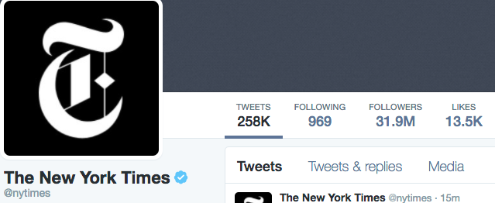
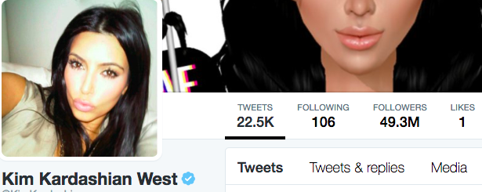
Notes:
Note that being verified and number of followers isn’t always a great representation of trustworthiness

Slide 6
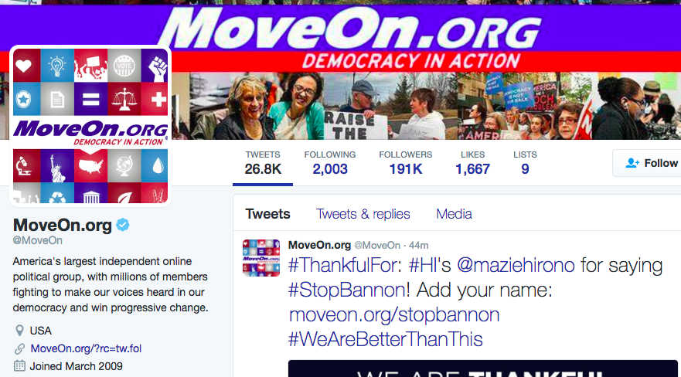
Notes:
An interesting trend that emerged from our think-aloud interviews was that more than half of students failed to click on the link provided within the tweet. Some of these students did not click on any links and simply scrolled up and down within the tweet. Other students tried to do outside web searches. However, searches for “CAP” (the Center for American Progress’s acronym, which is included in the tweet’s graphic) did not produce useful information. Together these results suggest that students need further instruction in how best to navigate social media content, particularly when that content comes from a source with a clear political agenda.
PROBLEMS:
According to the MoveOn.org Wikipedia page, MoveOn.org is a “progressive public policy” group and thus will most likely be against most any media or information distributed by the NRA. The criticisms section of the Wikipedia page cited more than one instance of MoveOn.org distorting the truth and even attempting to alter Google searches for their own benefit. I would seek a different source to know NRA members’ opinions on background checks.
WINEBURG: In search of expertise, we were led to professional fact-checkers at some of the nation's most prestigious publications. And we found that fact-checkers actually look at web content in ways that is - that are very different from what the typical user does. The typical user looks at web content when they come to a page that they're not familiar with, and they read it almost like a piece of print journalism. They read it vertically from up and down. What a fact-checker does when they land in an unfamiliar place - is that they take bearing. They almost immediately open multiple tabs, and they read horizontally. And they get a fix. But my question is that - who actually does this? What we really want to do is try to figure out how to make those five minutes worthwhile. MCEVERS: So basically teaching people to be fact-checkers. WINEBURG: Exactly. The kinds of duties that used to be the responsibility of editors, of librarians now fall on the shoulders of anyone who uses a screen to become informed about the world. And so the response is not to take away these rights from ordinary citizens but to teach them how to thoughtfully engage in information seeking and evaluating in a cacophonous democracy.

