Slide 1
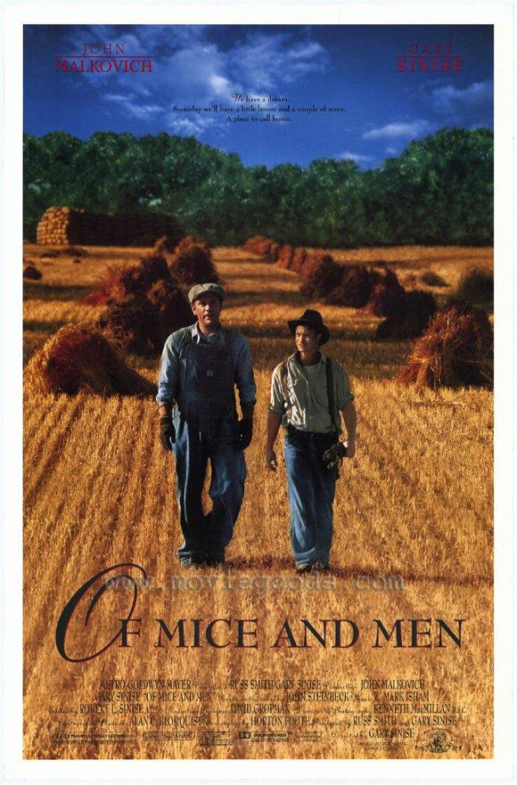
OF MICE AND MEN
By John Steinbeck
An introduction…

Slide 2
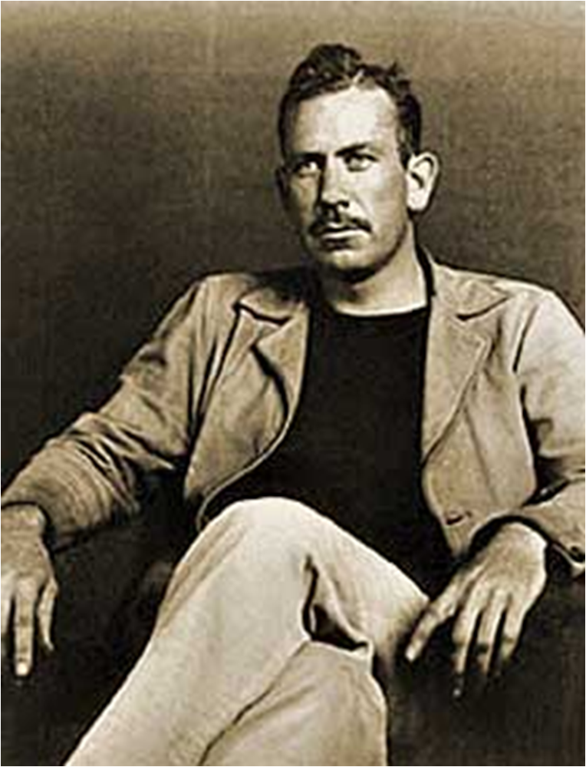
This is John Steinbeck
He is considered one of the most important of American authors
Notes:
This is John Steinbeck
This is John Steinbeck. He is considered one of the most important of American authors

Slide 3
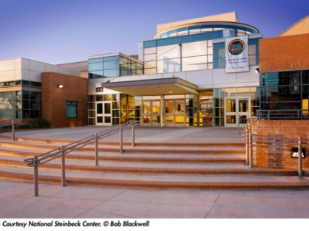
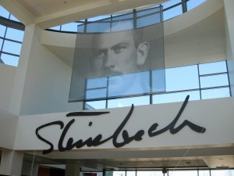
He is such a revered and loved author that he has his own museum : “The Steinbeck Centre” in California.
The reception area is actually his childhood home!

Slide 4
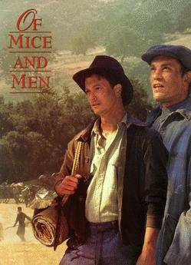
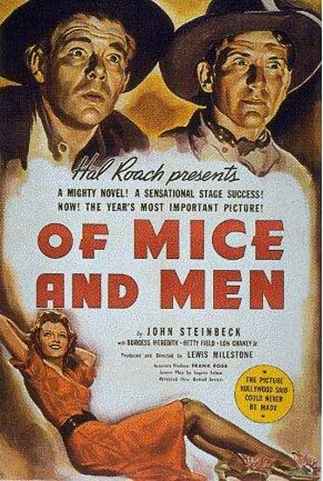
With the publication of his first novella- a short novel in 1937.
He gains world wide recognition. He goes on to write other powerful novels. (Grapes of Wrath)
In 1962 he wins the Nobel Prize for Literature.

Slide 5
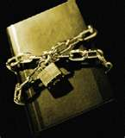
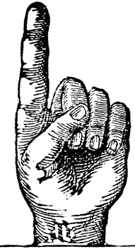
Reason 2:THIS BOOK IS OFTEN CENSORED
Even though Of Mice and Men is considered an American classic.
It is one of the most banned books
in American schools.

Slide 6
It is banned because of its language:
Examples:
Son of a bitch
Whore
Bastard
The “n” word

Slide 7
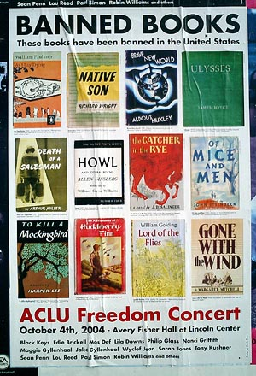
Here are some examples of other banned literature in American schools.

Slide 8
Of Mice and Men is controversial because of the way it depicts
women

Slide 9
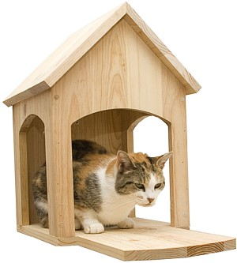
The book is also censored because the characters are rough & tough ranch hands. They spend most of their free time drinking alcohol and visiting prostitutes in what is known as a
“cat-house”.

Slide 10
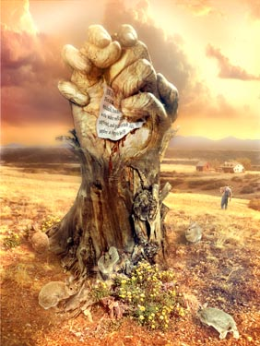
It’s about dreams, friendship, loneliness & violence

Slide 11
Reason 5
Reading some books makes you a better
person and this is one of them!

Slide 12
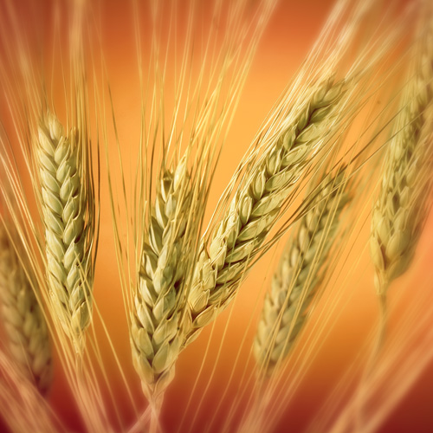
Before the 30s farm life was booming in America. Farmers were trying to cash in on the biggest crop of the day: wheat!

Slide 13
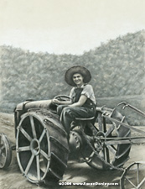
With the invention of better tractors, farmers could go crazy ploughing the land.
And they did.

Slide 14
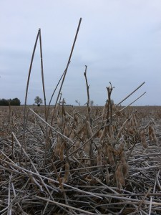
In those days they didn’t know a lot about soil conservation. When the crops failed year after year because of drought there was nothing holding the soil in place.

Slide 15
What happens to loose dry dirt in a big wind?

Slide 16
Dust!

Slide 17
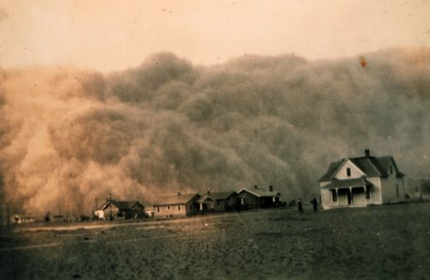
The Prairie winds made many dust storms

Slide 18
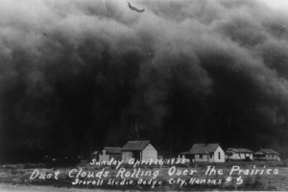
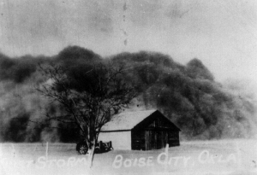
Black Sunday April 14, 1935. The dust storm that turned day into night. Many believed the world was coming to an end.

Slide 19
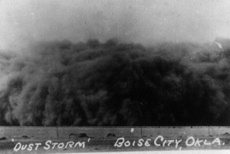

Slide 20
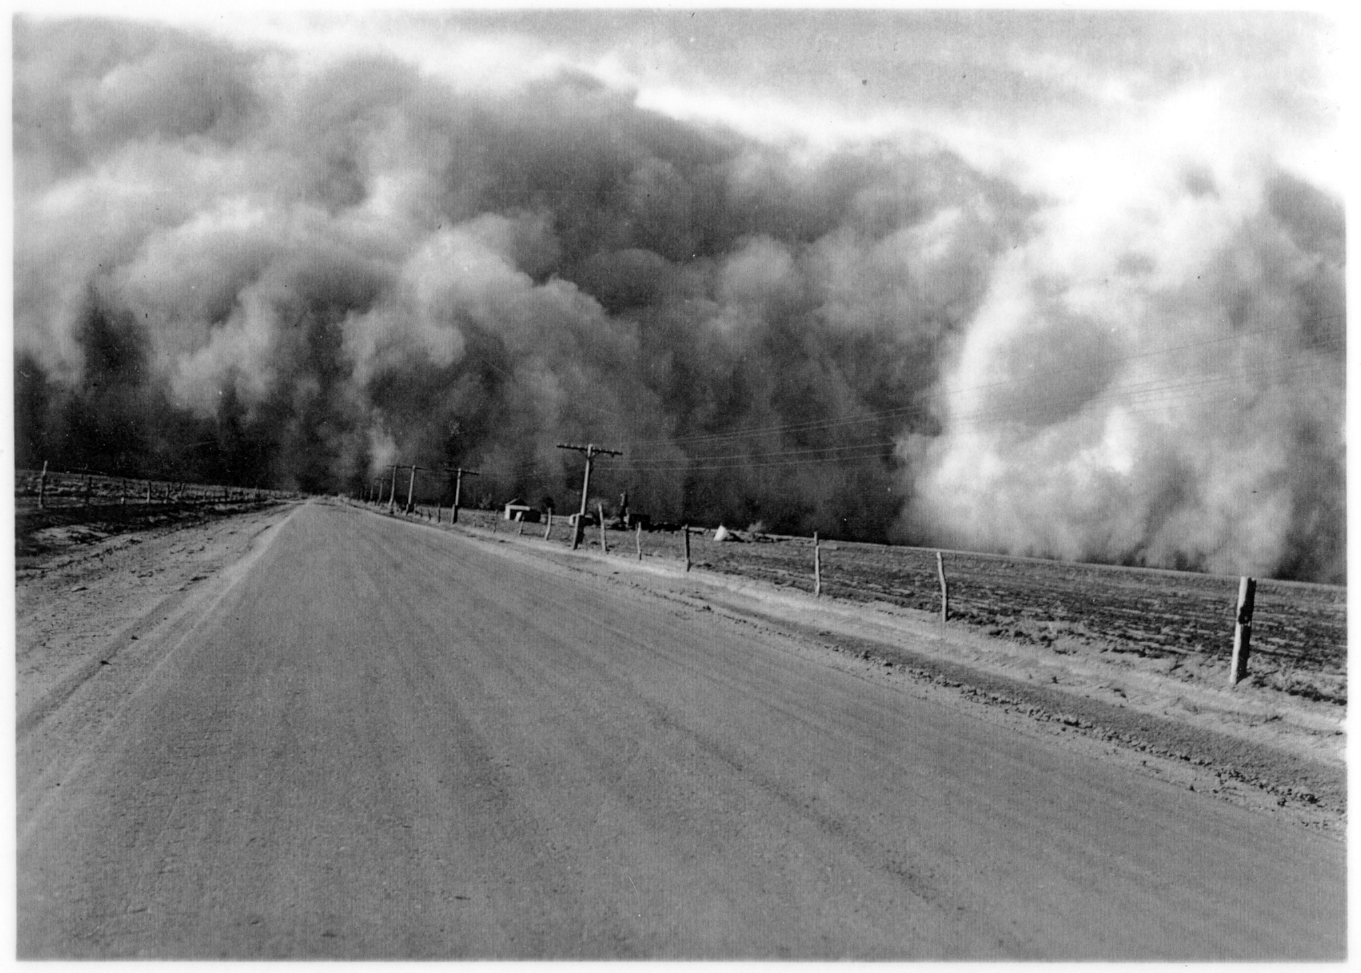

Slide 21
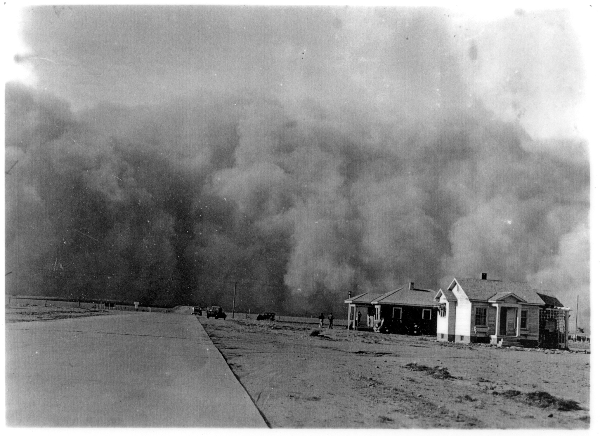

Slide 22
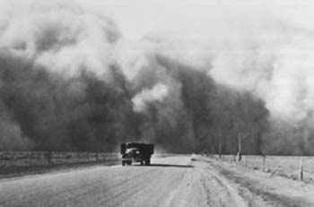

Slide 23
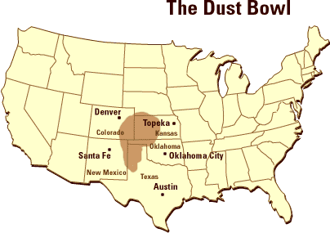

Slide 24
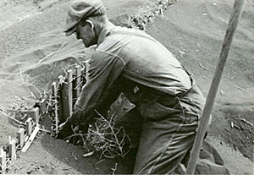
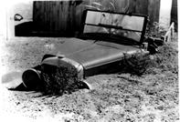
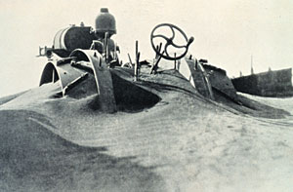
Notes:
The clouds appeared on the horizons with a thunderous roar. Turbulent dust clouds rolled in generally from the North and dumped a fine silt over the land. Men, women and children stayed in their houses and tied handkerchiefs over their noses and mouths. When they dared to leave, they added goggles to protect their eyes. Houses were shut tight, cloth was wedged in the cracks of the doors and windows but still the fine silt forced its way into houses, schools and businesses. During the storms, the air indoors was "swept" with wet gunny sacks. Sponges were used as makeshift "dust masks" and damp sheets were tied over the beds.

Slide 25
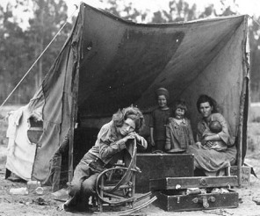
They took to the road. Where would they go?

Slide 26
California had great farmland and no dust.
They would migrate to California

Slide 27
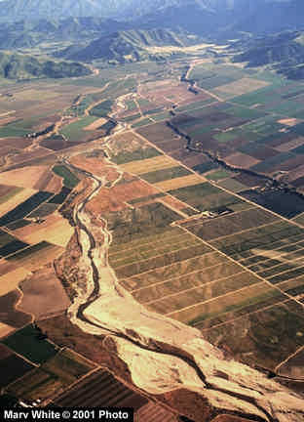
The Salinas River area in California.
Where Steinbeck grew up & worked on ranches.
Into this area came many jobless men
in the 30s.

